Slide 1

Oyster River
Cooperative School District
Proposed 2019-20
School District Budget
Deliberative Session
February 5, 2019
Visit our website at www.orcsd.org to view this presentation

Slide 2
Warrant Article #3
ARTICLE 3: Shall the District raise and appropriate as an operating budget, not including appropriations by special warrant article and other appropriations voted separately, the amount set forth on the budget posted with the warrant or as amended by vote of the first session, for the purposes set forth therein, totaling $47,405,510. Should this article be defeated, the operating budget shall be $46,850,794 (Default Budget) which is the same as last year with certain adjustments required by previous action of the District or by law; or the District may hold one special meeting in accordance with RSA 40:13, X, and XVI to take up the issue of the revised operating budget only. The School Board recommends this appropriation. (Majority vote required)
Note:
Fund 10 = $ 45,940,460 (regular operating budget); Fund 21 = $ 824,050 (expenditures from food service revenues); Fund 22 = $ 600,000 (expenditures from federal/special revenues); Fund 23 = $ 41,000 (expenditures from pass through funds).

Slide 3
2019-20 Board Goals
Choose a site for the new middle school and develop design plans.
Adopt 2019-2024 Strategic Plan.
Present findings of start time student survey.
Report on progress of ORMS competency-based learning.
Report on progress of ORHS competency-based learning.
Report on progress of one to one technology in the middle school.
Provide feedback on new high school schedule.
Report on World Language at the middle school and possible expansion to the elementary schools.

Slide 4
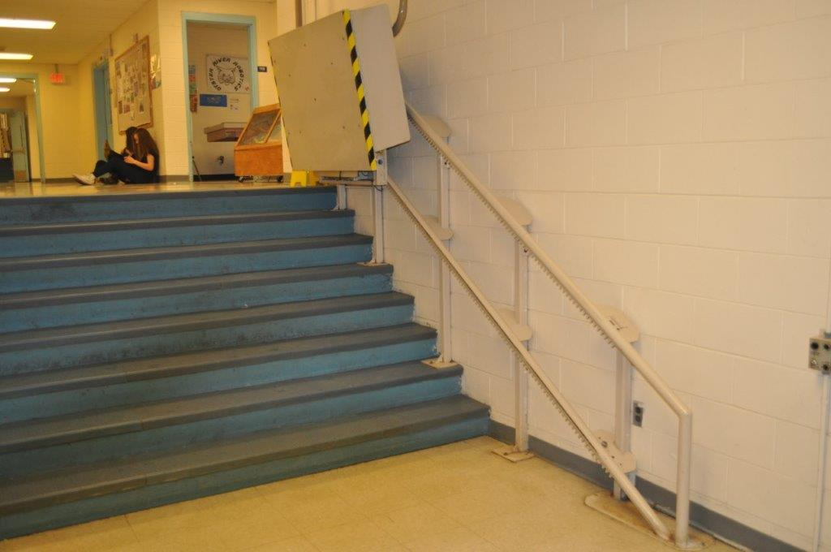
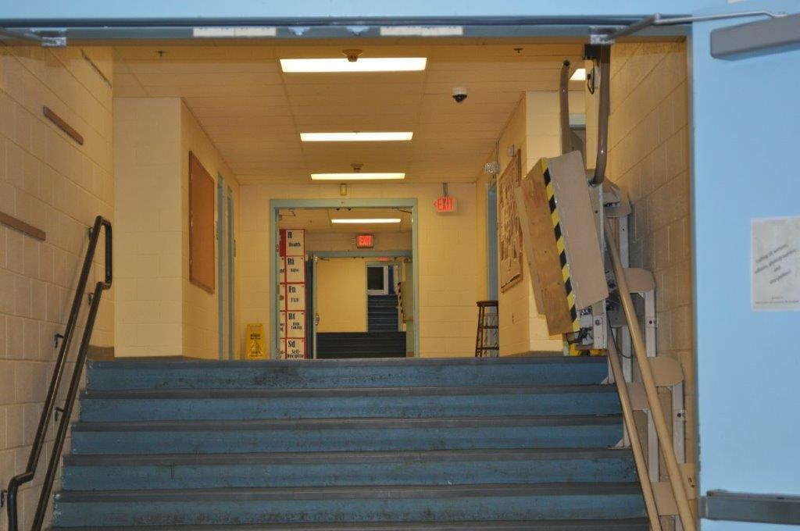
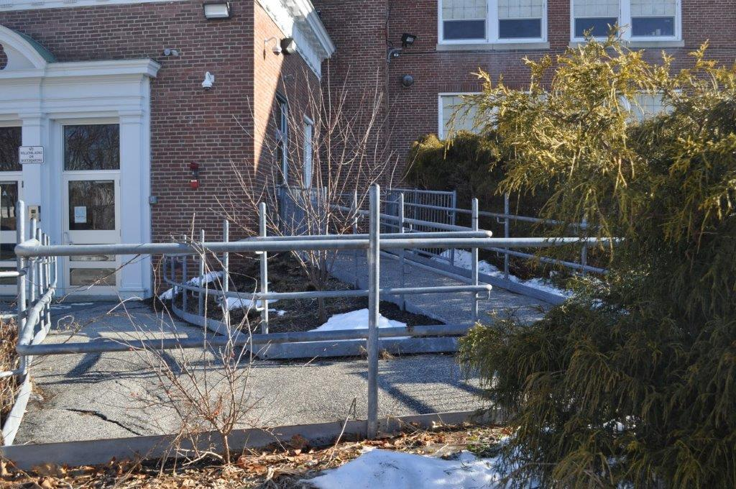
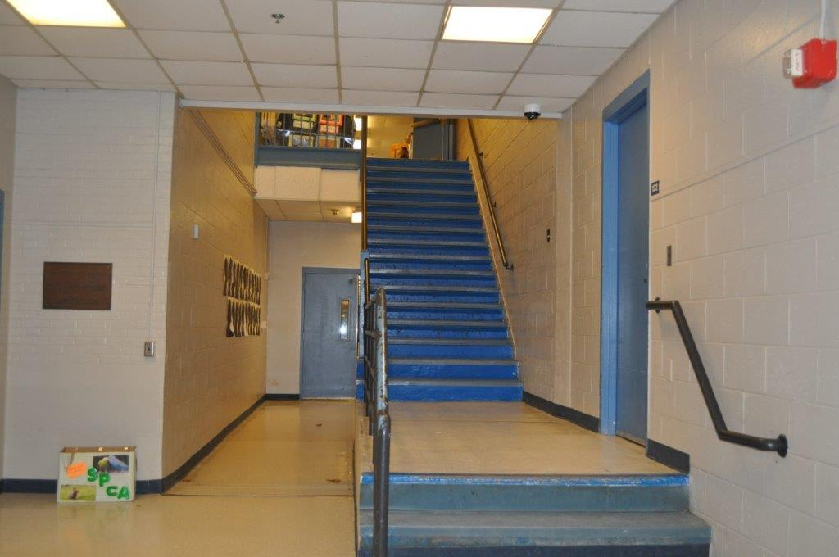
Current Middle School
ADA
Compliant:
Barely

Slide 5
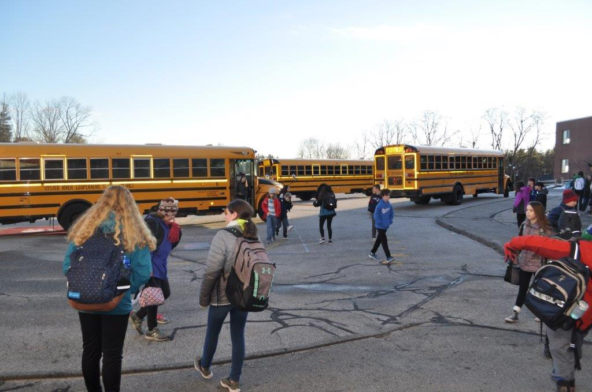
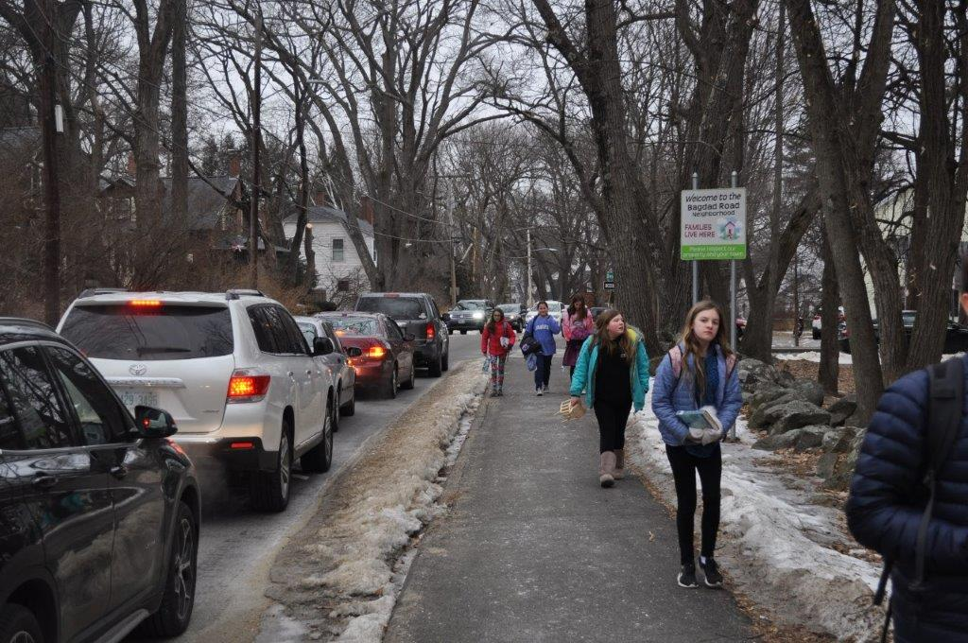
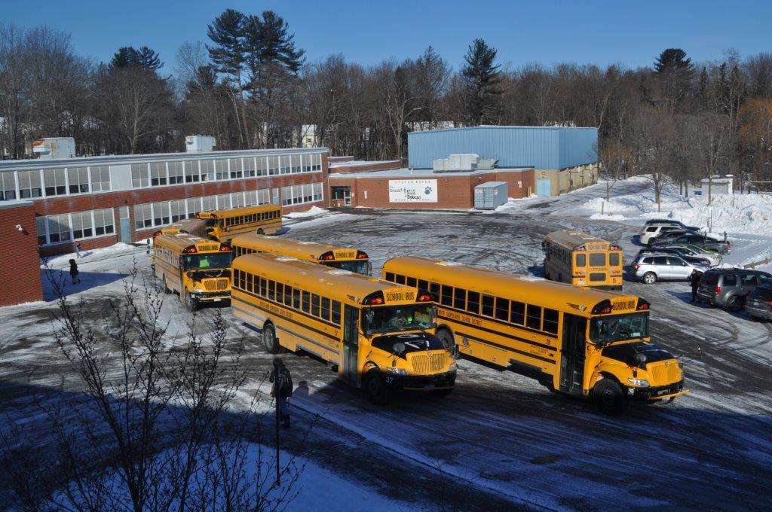
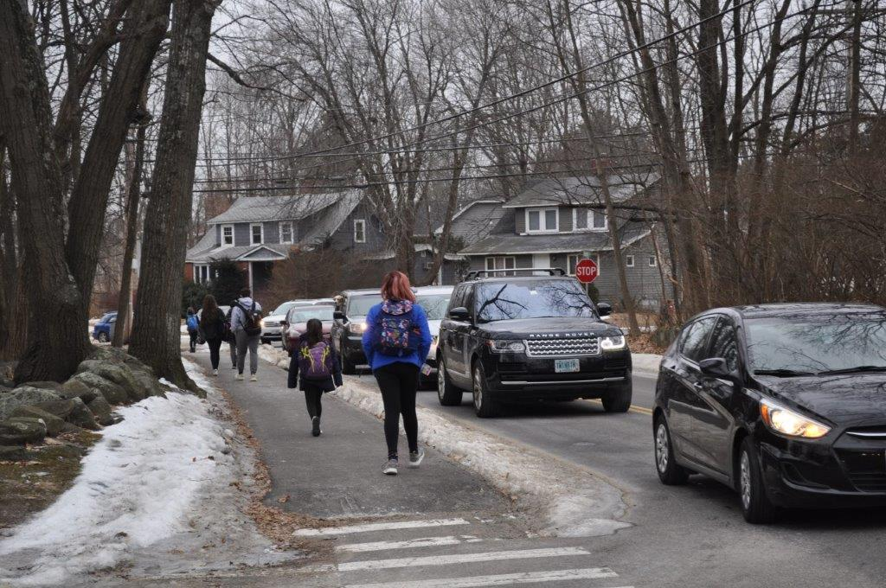
Current Middle School
SAFETY
ISSUES

Slide 6
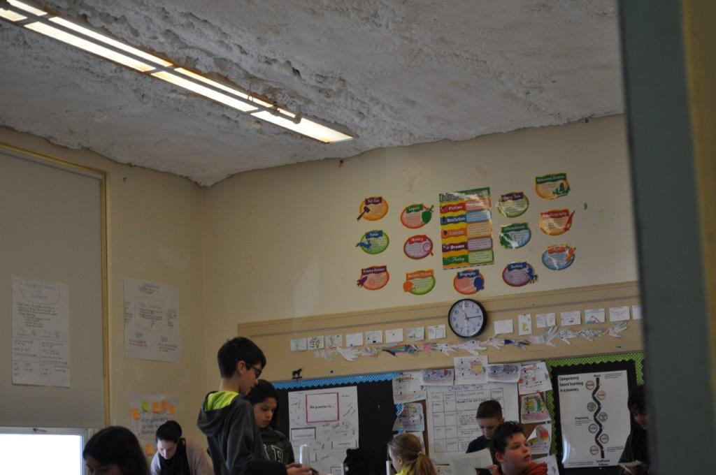
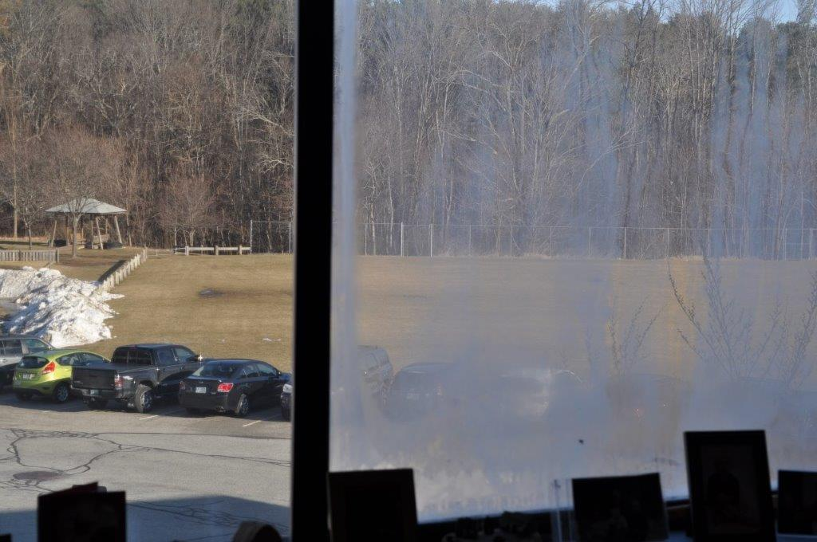
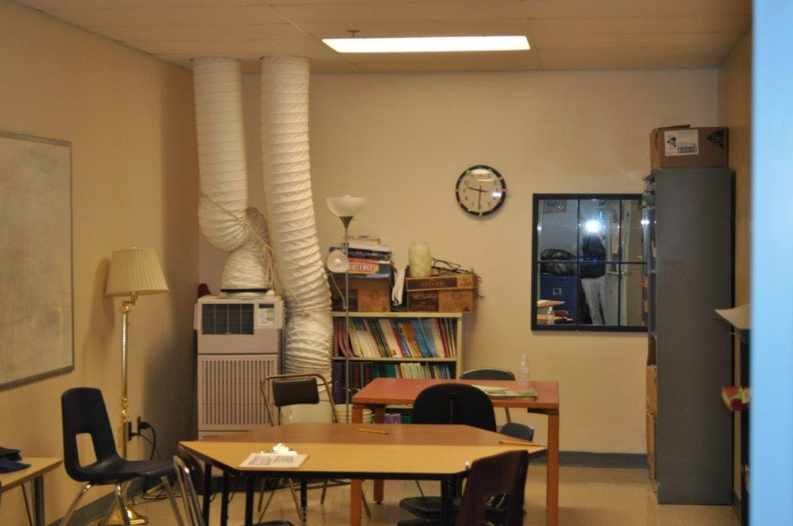
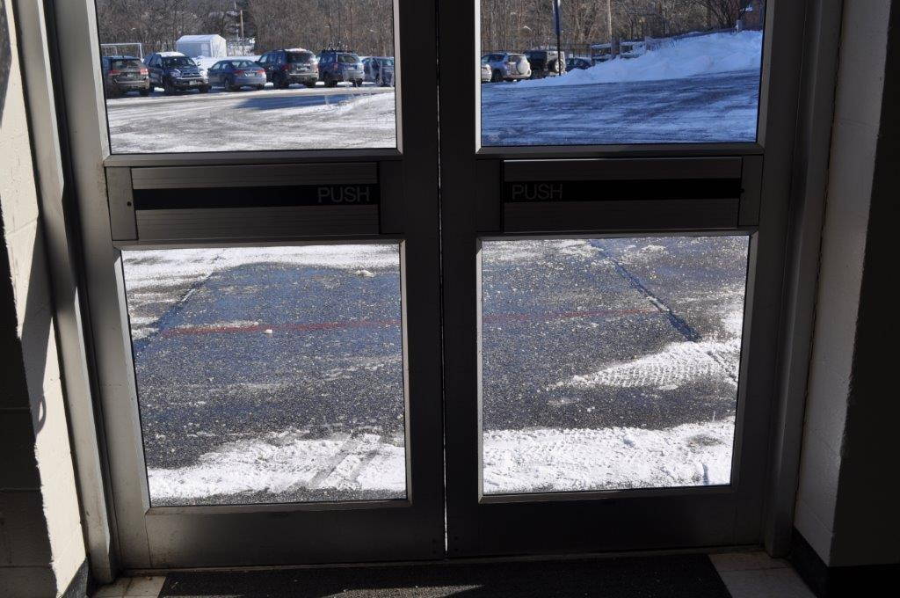
Current Middle School
RENOVATIONS

Slide 7
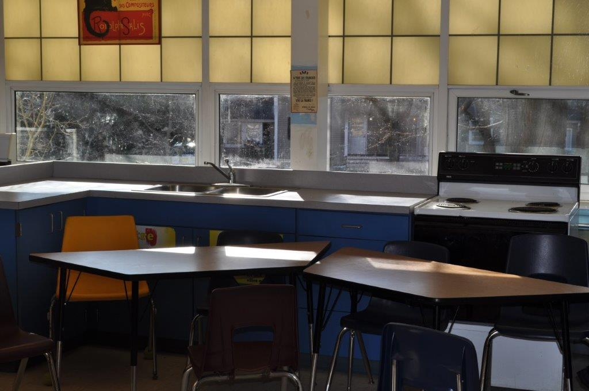
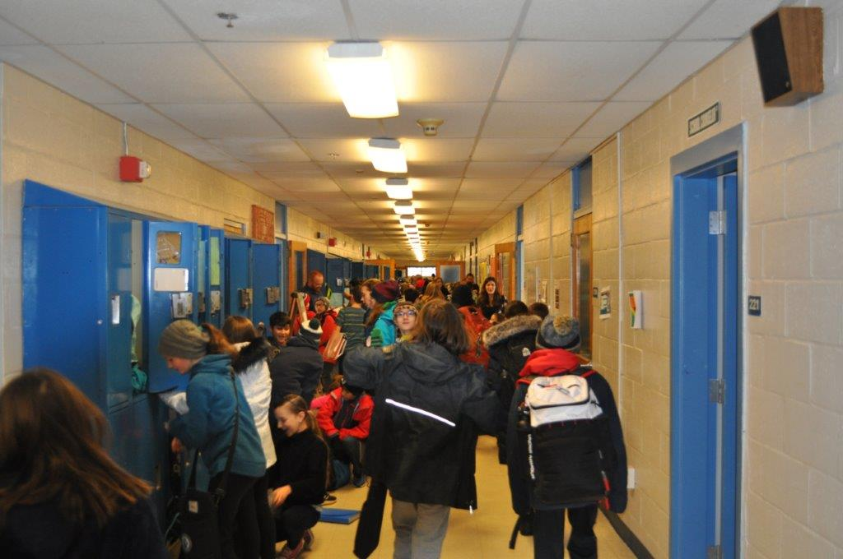
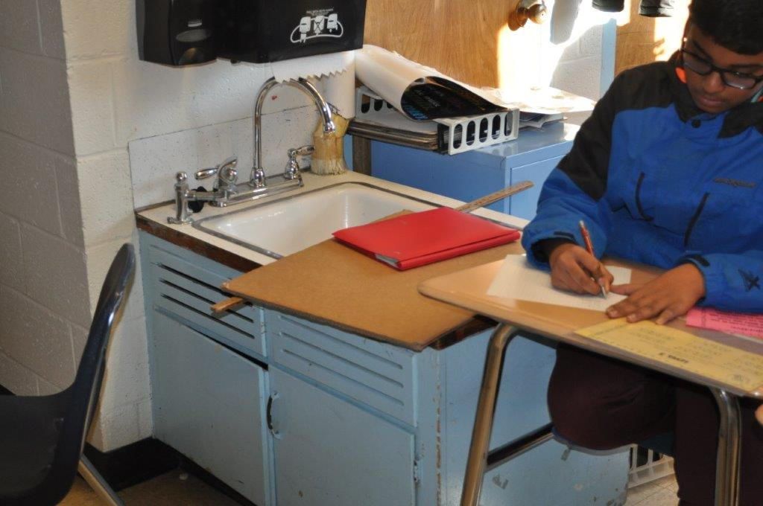
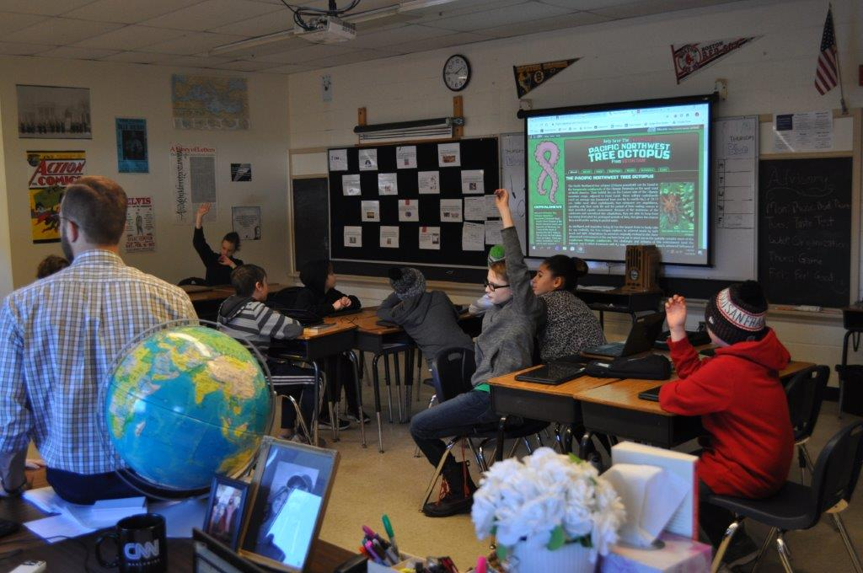
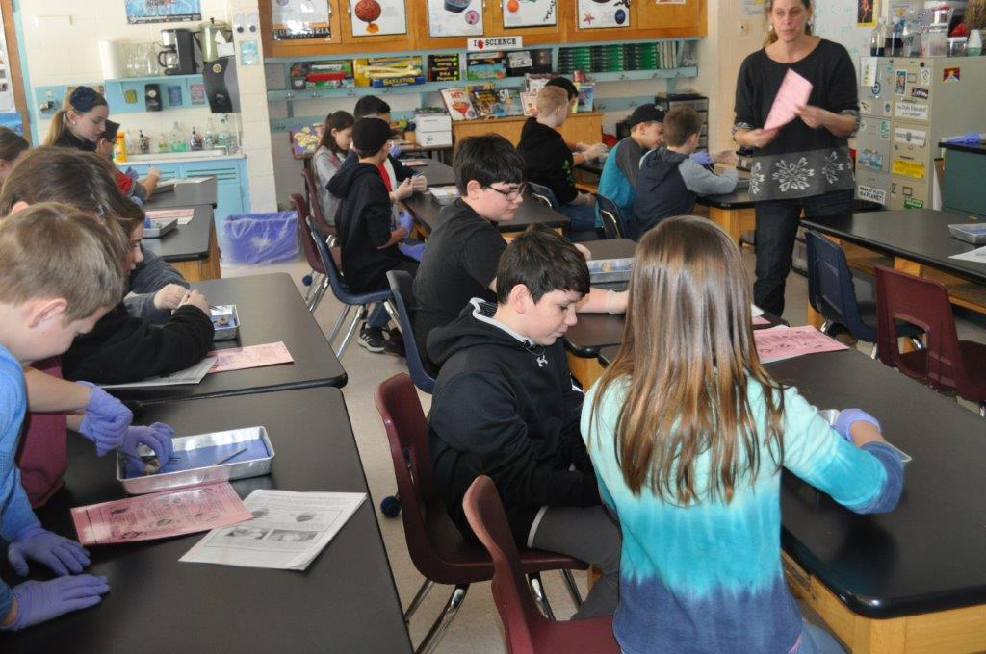
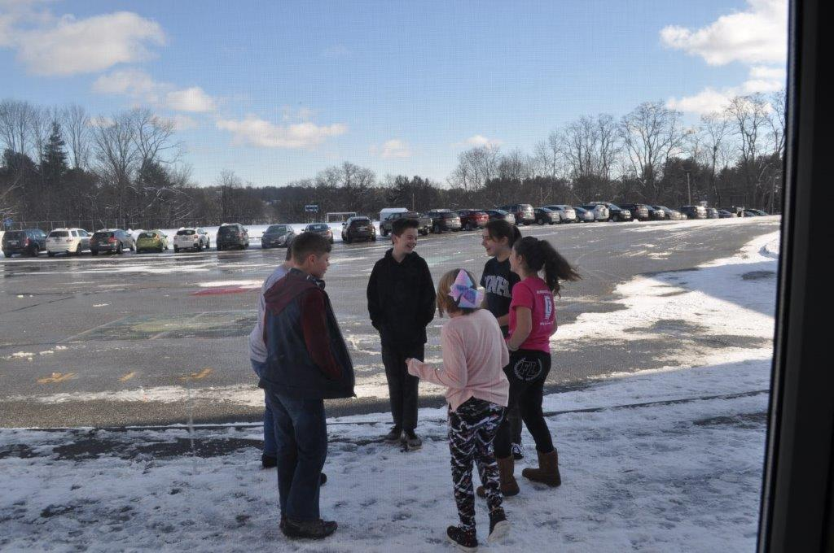
Current Middle School
ACADEMIC
DISTRACTIONS

Slide 8
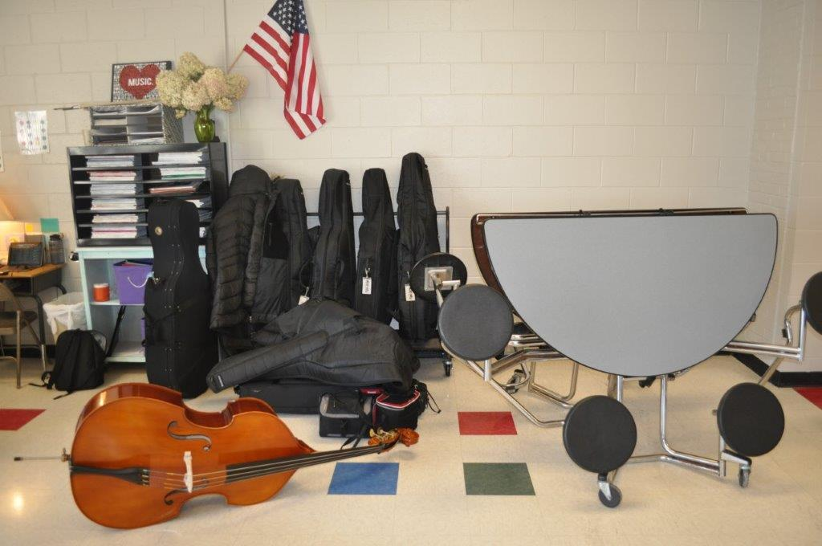
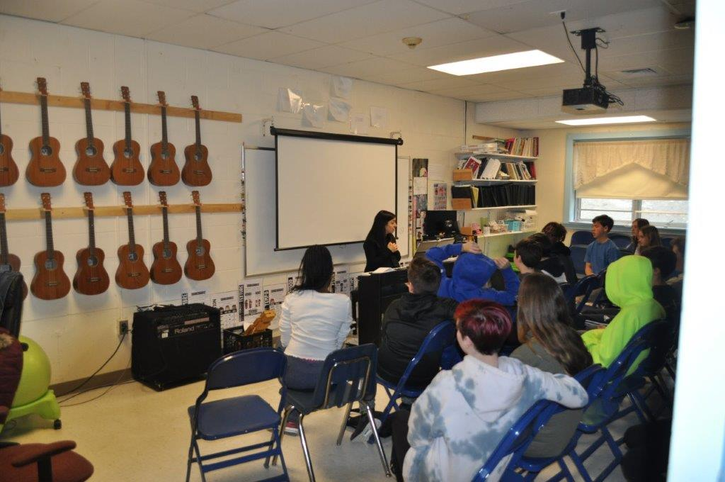
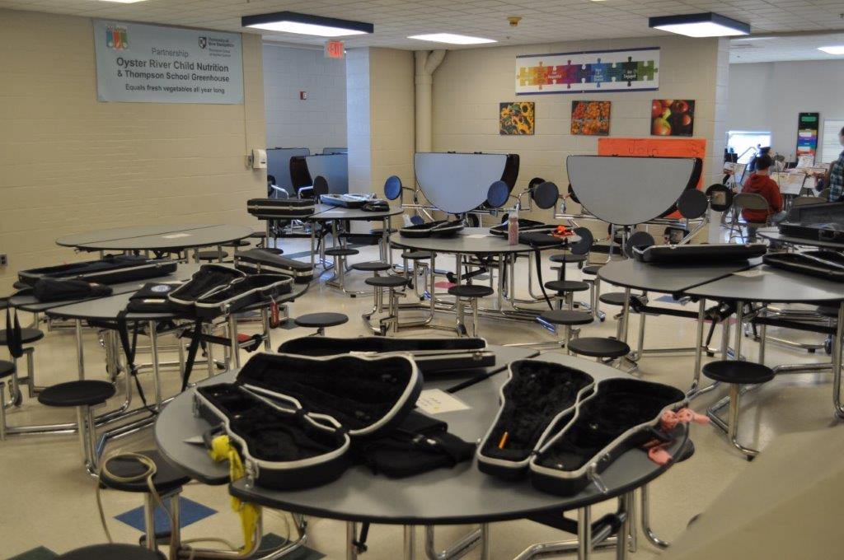
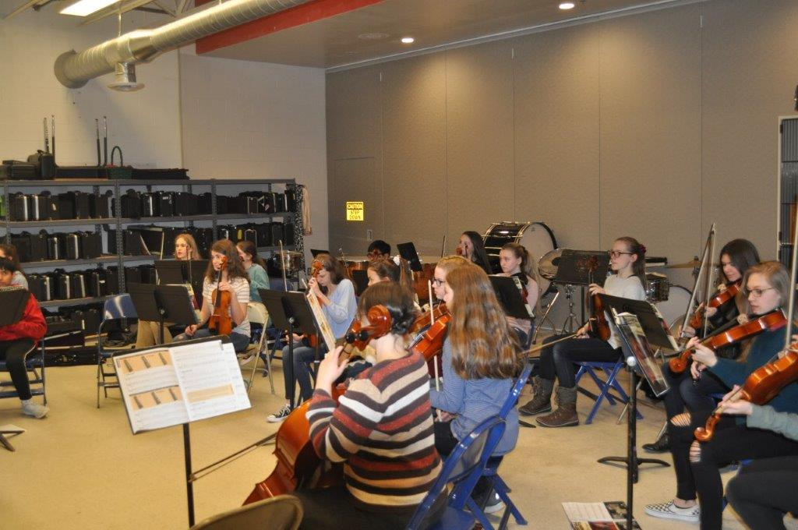
Current Middle School
MUSIC

Slide 9
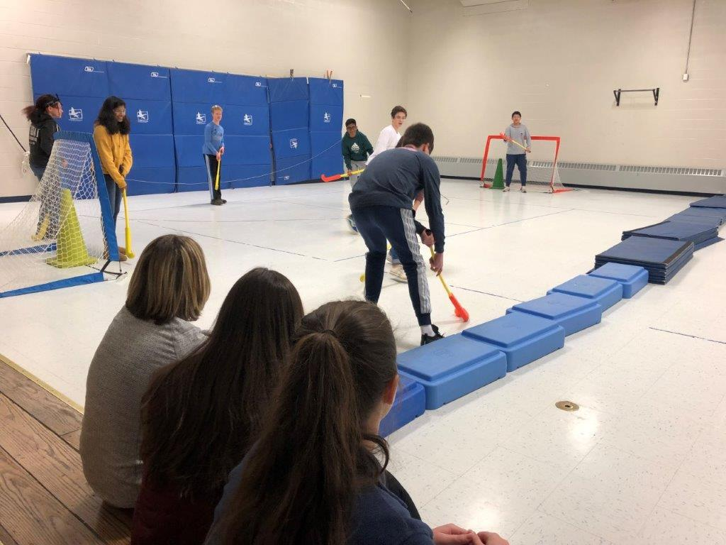
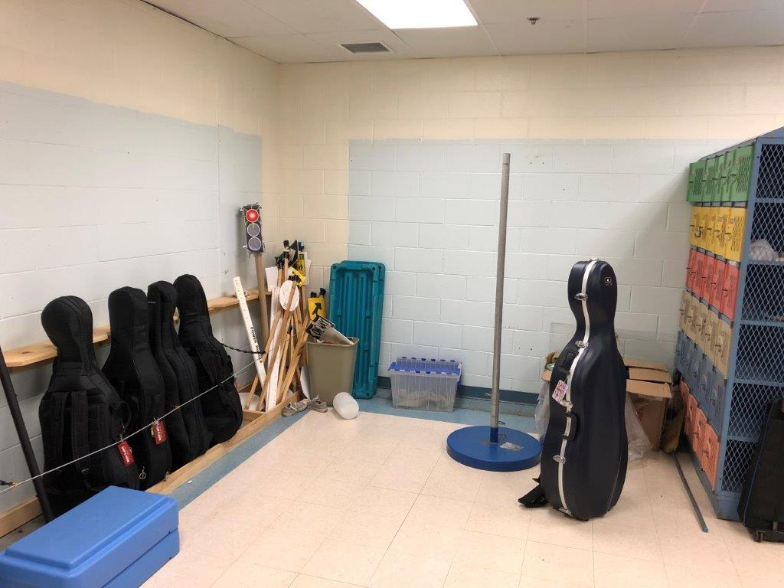
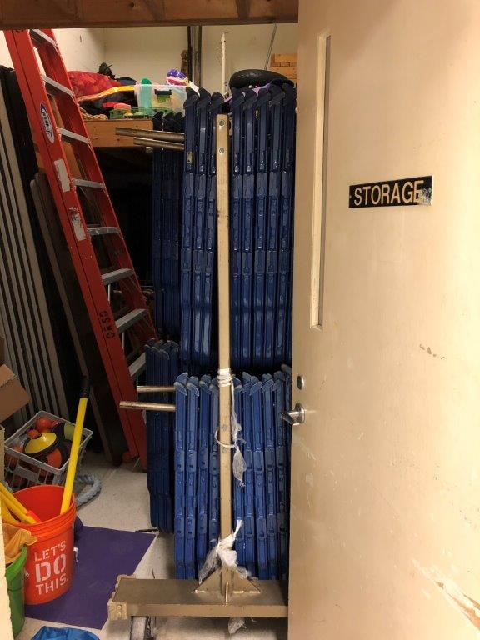
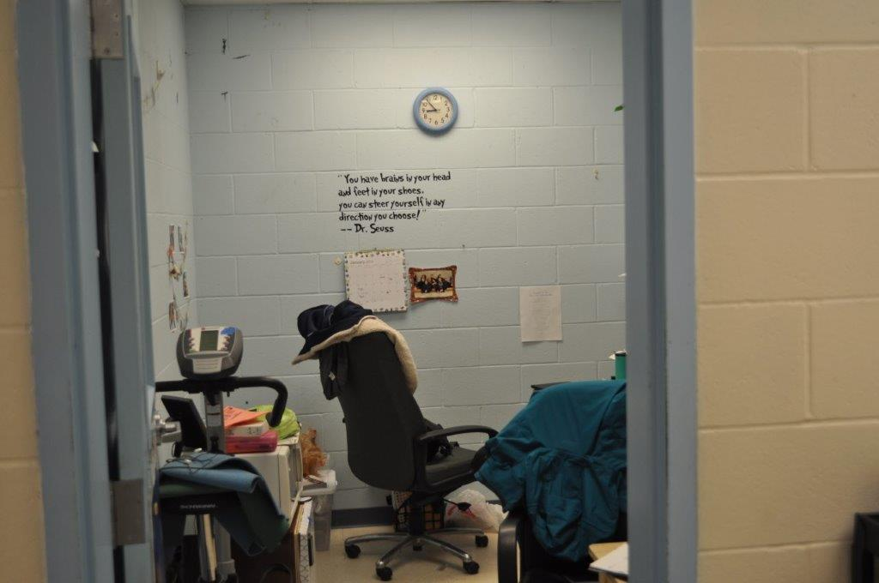
Current Middle School
PHYSICAL
EDUCATION

Slide 10
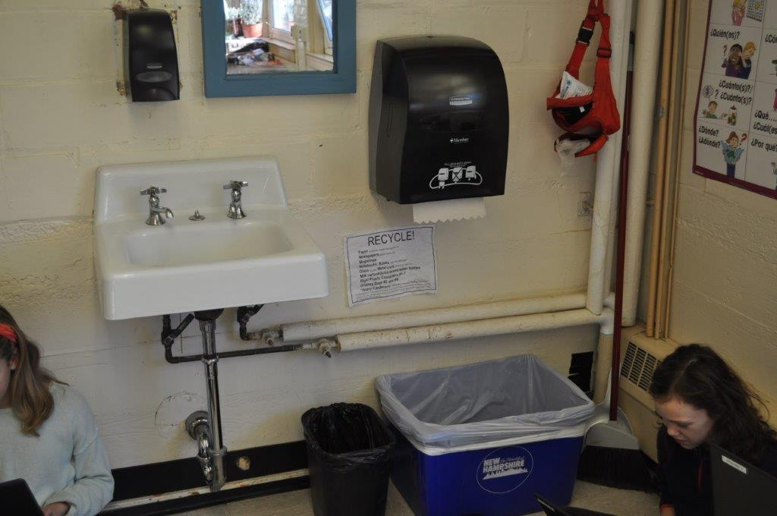
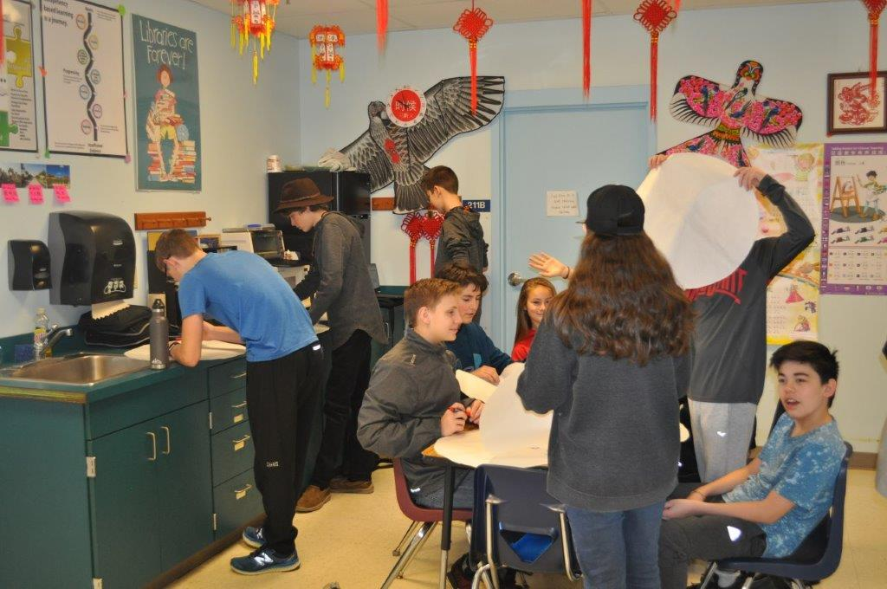
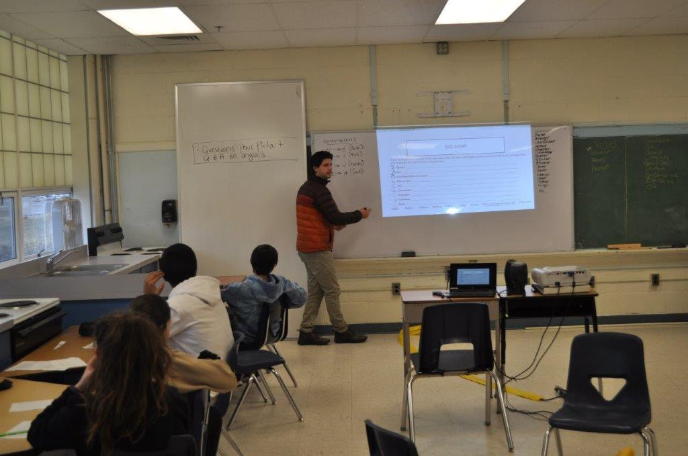
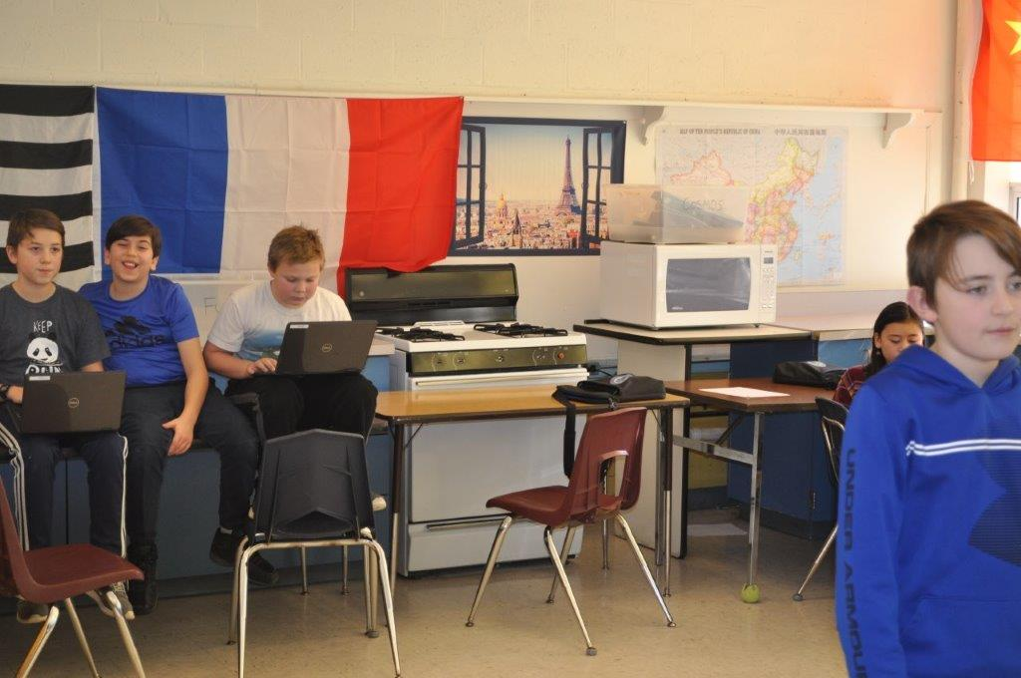
Current Middle School
WORLD
LANGUAGE
CLASSES

Slide 11
Current Middle School

Slide 12
Proposed Middle School
Presentation
Lavallee/Brensinger Architects
Ron Lamarre

Slide 13
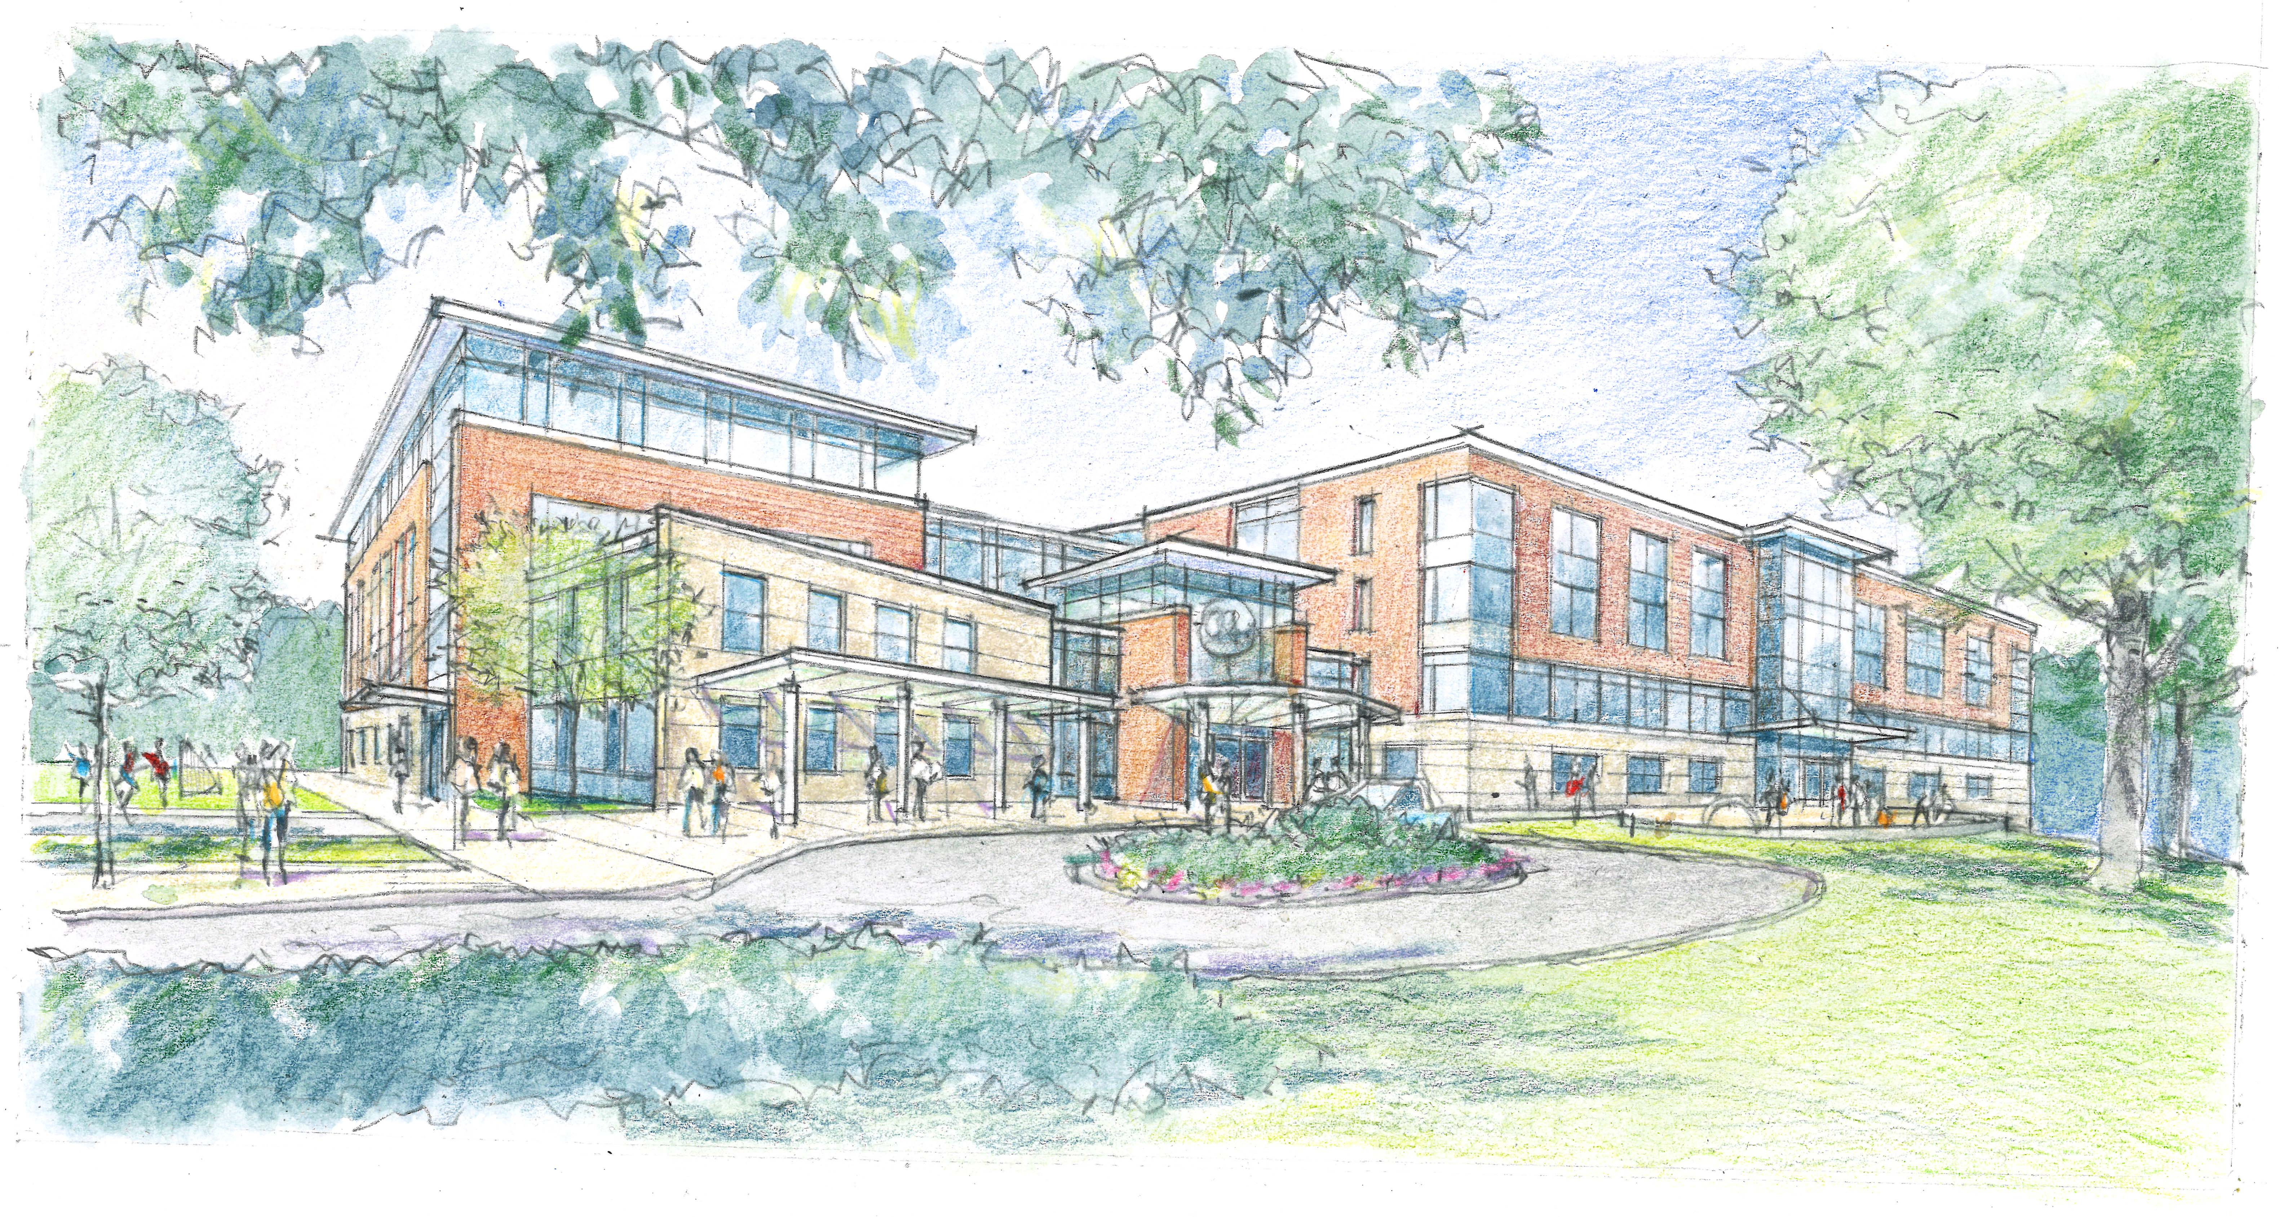
Proposed Middle School

Slide 14
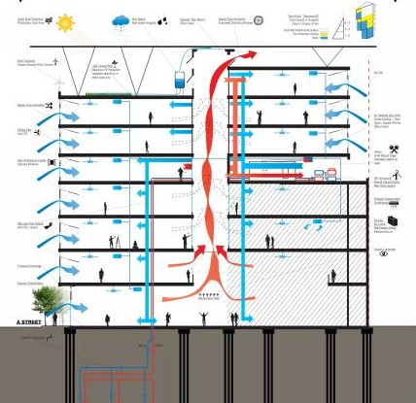
SUSTAINABILITY
Notes:
Leigh

Slide 15
TIMELINE
May
2019
Schematic
Design
November 2019
GMP
Budget
February 2020
Site and
Structure
March 2019
Design Phase
May
2020
Start
Construction
March 2022
School
Opens
August 2022
Site
Complete
March 2020
Construction Phase
Notes:
Leigh

Slide 16
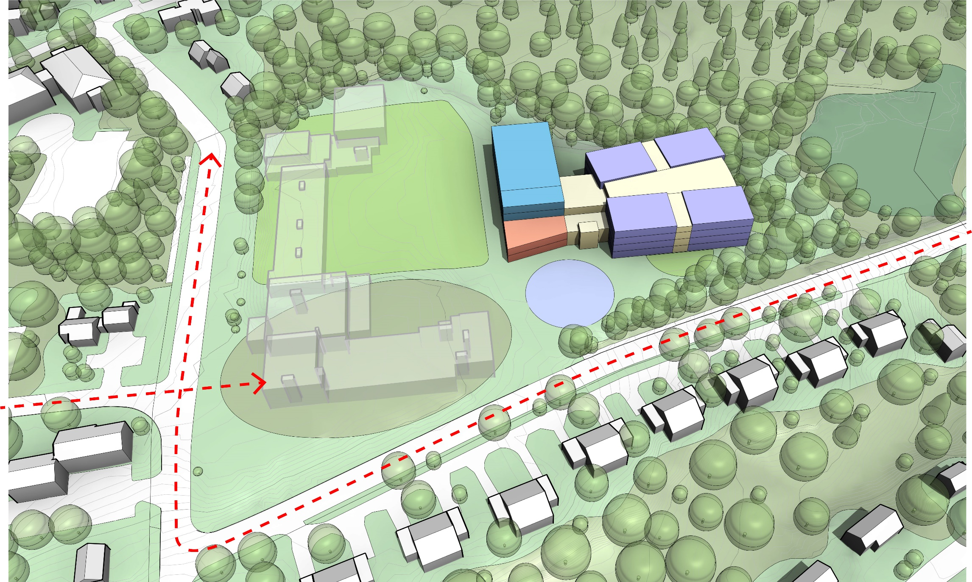
MASSING and TRAFFIC STUDY
Notes:
Leigh

Slide 17
School Board 2019-20 Budget Goal
The School Board’s budget goal was to limit the net spending increase in the 2020 budget from the 2019 budget to between 3.25% to 3.75%.
  The budget includes a $1,663,818 increase in spending from the approved 2018-19 budget. This represents a 3.75% increase with 3.49% impact.
  Revenue is projected to increase $302,700.
  New spending minus projected revenue is $1,361,118. This represents a 3.49% net increase.

Slide 18
COMPLETED

Slide 19
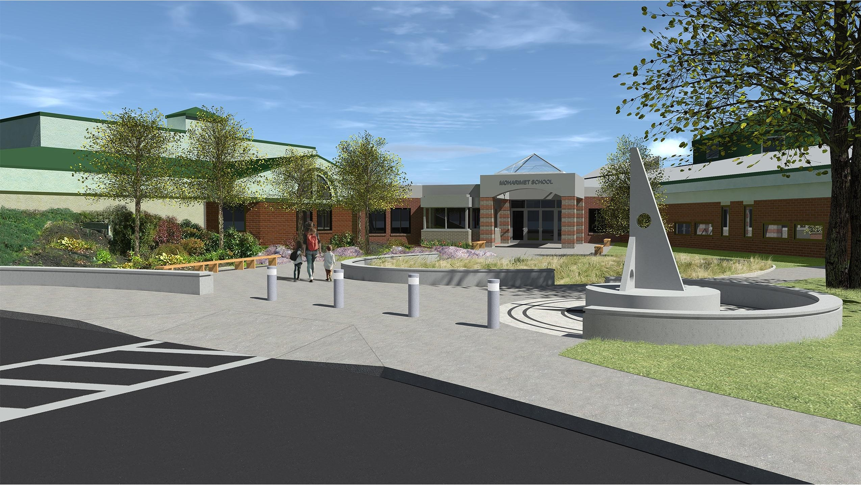
Moharimet Proposed Addition

Slide 20
Moharimet Proposed Addition

Slide 21
FY20 Increases
21
Major Drivers/Expenditure
  Negotiated agreement with ORESPA $ 41,378
  5.7% Increase in Health Insurance $313,500
  Capital Account: funds for MS Project $800,000
  Capital Account: Moharimet Project $755,320
  Staffing: 1 Counselor & 1 Elem. Asst. SpEd Dir. $206,000
  GUILD Agreement (Year 3 of 3) $587,169
  $2,703,367

Slide 22
Town Apportionment of the 2020 Budget
22
  Each town’s percentage of the school budget is determined by their average number of students and their equalized property value.
Town | % of Budget |  | % Change | Total Dollars
Durham | 53.8495 | 53.3714 | -0.089 | 18,356,457*
Lee | 30.1769 | 31.1264 | 3.15 | 9,407,203*
Madbury | 15.9736 | 15.5022 | -2.95 | 4,787,321*
FY19
FY20
  *Does not include state tax.

Slide 23
Changes in Equalized Value and Average Number of Students
23
Town | Change in Average Number of Students | Change in Equalized Value | Net Apportionment Change
Durham | -0.014% | 5.95% | 590,213
Lee | 2.24% | 12% | 775,480
Madbury | -4.35% | 6.1% | 103,375

Slide 24
Estimated
FY20 IMPACT TO TOWNS
24
Town | Increase per $1000 | % of Change
Durham | 0.52 | 3.04
Lee | 1.91 | 8.88
Madbury | -0.20 | -0.89

Slide 25
Warrant Article #4
25
Shall the District vote to approve within the provisions of New Hampshire RSA 273-A:3 the cost items included in the collective bargaining agreement reached between the Oyster River Educational Support Personnel Association and the Oyster River School Board which calls for the following increases in salaries and benefits at the current staffing levels:
2019-2020 $ 41,378
2020-2021 $ 45,532
2021-2022 $ 48,809
and further to raise and appropriate the sum of $ 41,378 for the 2019-2020 fiscal year, such sum representing the additional costs attributable to the increases in salaries and benefits required by the new agreement over those that would be paid at current staffing levels? The School Board recommends this appropriation. (Majority vote required)

Slide 26
Warrant Article #4 CONTINUED
ORESPA – Oyster River Educational Support Personnel Association
Covers all Custodians and Administrative Support Personnel
Negotiated a 3 Year Contract
    2019- 20
    2020- 21
    2021- 22

Slide 27
Warrant Article #4 continued
Benefit/Language Changes:
Addition of new Health & Safety Language
Clarifying Language added to Employment Status for School Year Secretaries/Administrative Assistants
Probationary Period changed from 30 to 90 days
Clarifying Language added for Overtime/Personal Time
Clarifying Language added to Sick Bank Leave
Yearly Clothing and Uniform reimbursement of $100 to custodians
COLA Increase:
    Year 1 increase of Salary and Benefits of 3.0%
    Year 2 increase of Salary and Benefits of 3.2%
    Year 3 increase of Salary and Benefits of 3.3%

Slide 28
Warrant Article #4 CONTINUED
Impact of proposed ORESPA contract:
    2019-20 = $ 41,378 or 3.0%
    2020-21 = $ 45,532 or 3.2%
    2021-22 = $ 48,809 or 3.3%

Slide 29
FY20 Budget Impact
29
General Fund (10) TOTAL $45,940,460
Article 4 – ORESPA Contract $ 41,378
TOTAL with warrant articles $45,981,838 - 3.75%
With projected revenue increases 3.49% Impact

Slide 30
Default Budget
30
In the event that the FY2020 Proposed Budget fails to be approved by District voters, the Default Budget automatically becomes the budget for FY2020:
Default General Fund Budget $45,424,300
Default Fund 21 (Food Service) $ 785,494
Default Fund 22 (Federal Funds) $ 600,000
Default Fund 23 (Other Special Revenue) $ 41,000
Total Default Budget FY2020: $46,850,794
If the proposed Budget Fails ~ The Default Budget will be $554,716 less.

